Slide 1

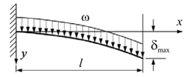
COMPUTER ASSIGNMENT MATLAB
DEFLECTION IN BEAMS (AREA MOMENT METHOD)
Group 9:-
Ripudaman Singh
Akshita Jain
Adriraj Chaudhuri
Ahemad Khan Pathan

Slide 2
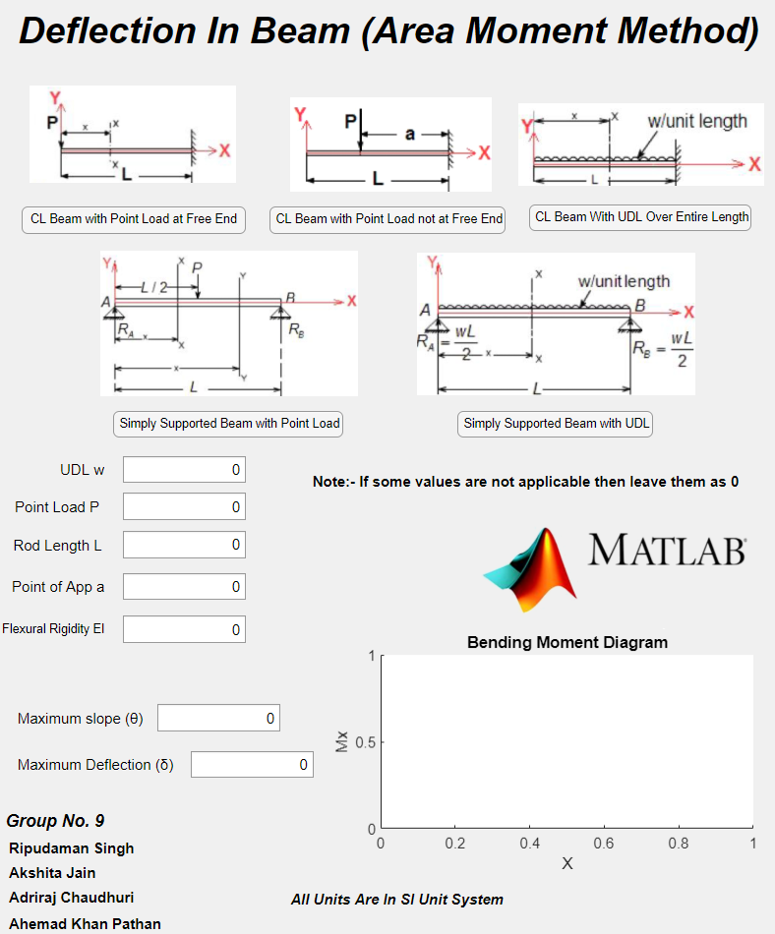
What we have here!
Matlab GUI Based Code which solves 5 problems based on Deflection in Beams By Area Moment Method.
All Units here in Input must be in SI system.
Our Code Implement the input and Calculate Maximum Slope and Deflection for the Case Chosen (by Pressing Buttons).
We also gave a plot of Bending Moment diagram as it is used theoretically to calculate Slope and Deflection.
We covered Cantilever Beams and Simply Supported Beams with 5 Different Cases.

Slide 3
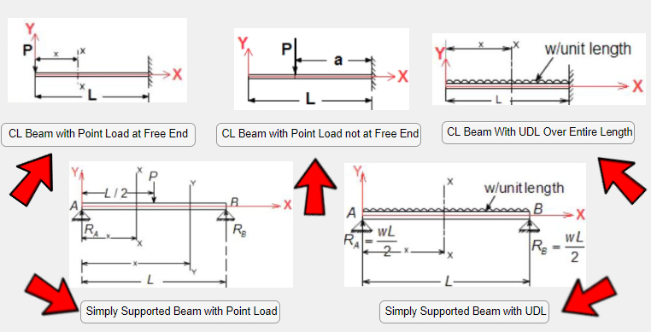
Buttons
Our Code Starts Basically from these buttons which differentiate between the cases.
So we added call back matlab gui function to each of these five buttons and implemented our code.
Figures have been provided to have a better representation of the cases.

Slide 4
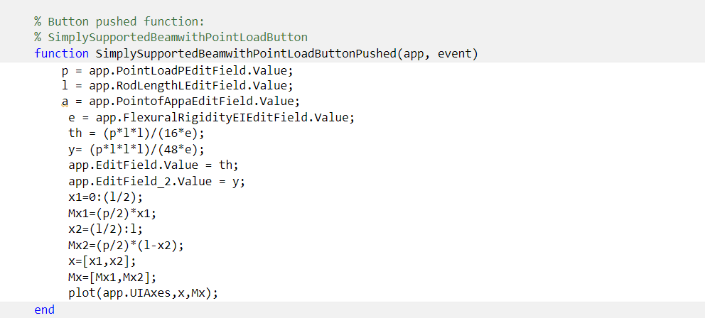
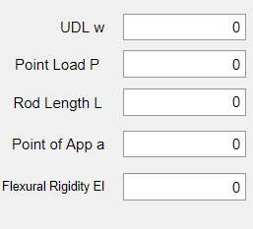
What’s Inside Callback functions?
In Callback functions we are taking Input from user and assigning them to their respectative variable.
For Input we used “Numeric Edit Field” from component library (Picture shown).
Then we applied our formulas from area moment method and converted them as per program readable format.
We also used “plot” function to plot Bending Moment Diagram for the respective cases.

Slide 5
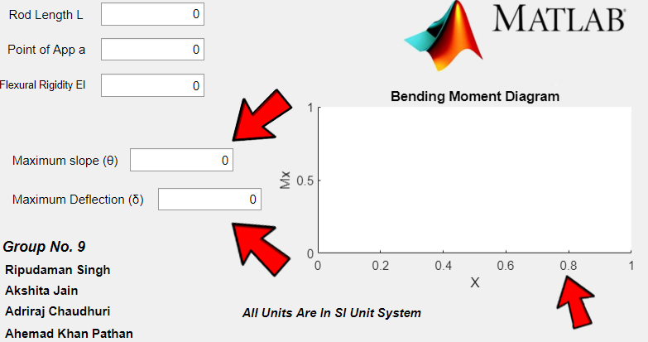
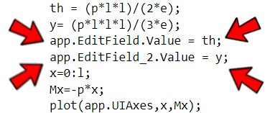
Output & Bending Moment Diagram
For Output also we used “Numerical Edit Field” from Component Library in Matlab GUI App Designer.
For output display “.Value = var” function was used.
And for Bending Moment Diagram As stated Earlier we used Plot.

Slide 6


